Slide 1
Welcome! MKT 591 Marketing Analytics: Introduction

Slide 2
Today’s Agenda
Introduce ourselves
Go through class syllabus
Discussion
What is Marketing Analytics?
What is Models?
Overview of R software

Slide 3
Logistics
Sunghoon Kim
Email: Skim348@asu.edu
Phone: 480-965-6205
Office Hours
BAC 491
Office Hours: Tuesday/Thursday 11:40 AM – 1:20 PM or by appointment

Slide 4
Sunghoon’s Background
Research Interests : Empirical Modeling in Marketing
Developing New Market Segmentation Methodologies
Analyzing Online data & Unstructured Data by text mining
Spatial Modeling & Geographical Analysis
Quantitative Areas & Education
Statistics, Bayesian Statistics, Clustering Models, Data Mining/Machine Learning, Psychometrics.
PhD in Marketing and Operation Research, Master in Statistics, Pennsylvania State University.
Industry Experience
Marketing Practitioners in Food Industry and Service Industry
Teaching
Marketing Analytics, Marketing Research

Slide 5
Please introduce yourself
Name/Major
Hobby
What makes you take this course?

Slide 6
Syllabus

Slide 7
Class Objectives
Modern data analytics come from various quantitative disciplines such as statistics, computer science, economics, industrial engineering, etc., and the main difference of this course from other analytics courses will be the marketing-oriented methods and their associated marketing implications.
The essence of marketing analytics is to help marketing managers make informed decisions by finding and understanding meaningful patterns in the various types of data.

Slide 8
Action Goals
1. Understanding some important methods useful in marketing analytics -- models, concepts and technical terms.
2. Learning how to practically analyze the data using tools/software (we’ll use R in this class)
3. Applying the results of analysis to inform marketing problems (e.g., finding meaningful patterns, interpretation, discussion of managerial implication etc.)

Slide 9
Course Prerequisites
You should be interested in quantitative analysis of various marketing data. Also, this course assumes that you already have some basic statistical knowledge such as correlations, parameter estimations, and linear regressions.
Finally, you are willing to learn analysis software, R through hands-on learning. I believe deep understanding of one analysis software will provide strong learning capability to easily learn other kinds of software. Please bring a Laptop computer to class.

Slide 10
Required:
Textbook: R for Marketing Research and Analytics by Christopher N. Chapman, Elea McDonnell Feit, Springer 2015th Edition
Laptop computer (You can rent it from IT service, W.P. Carey School of Business)
Software: R (free download) and Excel

Slide 11
Grading Policy
Data Analysis Exercises using R 150 (3 Assignments).
Marketing Analytics Team Project: 150.
Final Presentation 50
Final Report 100
Final Exam 150.
Total: 450 points.

Slide 12
Data Analysis Exercise using R (150)
There will be 3 individual assignments (50 per each assignment) for data analytics exercises (Mostly using R).
The objective of these exercises/mini-cases is to let you study the analytics method you learned during classes and practice the analysis tools commonly used in the industry.

Slide 13
Marketing Analytics Team Project
You are randomly assigned to a team of 5 or 6 members to work on a joint project (check your Blackboard).
Your team can select an interesting project of your choice with practical importance to solving a specific marketing problem, for instance, consumer segmentation & targeting, social media-based promotion campaign, prospective new customer identification, identifying key drivers for efficient resource allocation, etc. for a specific brand or organization.

Slide 14
Marketing Analytics Team Project
Public Secondary Data Sources:
Kaggle Datasets: https://www.kaggle.com/datasets
Yelp Challenge: https://www.yelp.com/dataset_challenge
Cultural Data: http://www.teradatauniversitynetwork.com/PARTNERS-2015/Data-Challenge/CDP-Data/
Hoopfest tournament survey data: http://www.spokanehoopfest.net/organization/Pages/history.aspx
Online review data: Star ratings and textual review data (e.g., Amazon.com, TripAdvisor.com or Yelp.com).
Others: your own company data or survey data.

Slide 15
Marketing Analytics Team Project
Your team will present the results to the entire class (28th of April). This presentation is expected to last approximately 12-15 minutes.
You can organize the presentation using sections such as an introduction (e.g., background, problem descriptions), data and methodology, analysis results, interpretation, managerial implications, summary and learning points.
You should submit a hard copy of your PowerPoint slides to the instructor before your presentation.

Slide 16
Team Project Report
You will have to submit your final report by 10:00 am, 2nd of May. Please do not exceed 12 pages using a 12 point font size. If you need more space for the analysis tables or graphs, you may use an appendix section. Please include the sections of executive summary, introduction, data and methodology, analysis, results, and actionable marketing implications.
At the end of the semester, you will be asked to evaluate each of your members’ contribution to the team project. You should be honest and impartial in your evaluations.

Slide 17
Final exam (150)
There will be a comprehensive in-class exam that covers all the materials discussed in this course. The purpose of the exams is to assess your understanding of concepts/methods, analysis skills and your ability to apply concepts learned during classes, class exercises and the group project.
Time and Place will be announced later.

Slide 18
WEEK | DATES | MANAGERIAL APPLICATIONS | ANALYSIS SKILLS | Note (Assignment)
1 | 15-Mar. |  | Course Overview, Introduction, R introduction | Examples of Analytics
1 | 17-Mar. |  | Review of Market Research and Quantitative Analysis
2 | 22-Mar. | Forecasting and find Key Drivers | Linear Regression
2 | 24-Mar. | Forecasting and find Key Drivers | Other Topics in Regression (Dummy coding, Variable Selection/Lasso)
3 | 29-Mar. | Choice Prediction | Choice Regression Methods with Cross Validations
3 | 31-Mar. | Demand Forecasting/Product Life Cycle | Bass Diffusion Model | Assignment 1 Due
4 | 5-Apr. | Forecasting | Classification Methods
4 | 7-Apr. | Underlying Dimension | Dimension Reduction Method: Factor Analysis | Assignment 2 Due
5 | 12-Apr. | Market Structure Analysis | Multidimensional Scale Methods
5 | 14-Apr. | Extracting Attributes | Text Mining: Online Review Data Analysis | Assignment 3 Due
6 | 19-Apr. | Market Segmentation | Market Segmentation: Concepts and Basic Methods
6 | 21-Apr. | Market Segmentation | Market Segmentation: Advanced techniques | Project Data Analysis
7 | 26-Apr. | Geographical Pattern Analysis | Spatial Model Analysis | Project Data Analysis
7 | 28-Apr. |  | Final Presentations | Due for the final paper: 10:00am, 2nd of May
 | 2 to 6 May |  | FINAL EXAM | Time and Place: TBA
Tentative Schedule
The content of this syllabus is tentative and is subject to change based on the needs of the class, the interest of class students and any other reason that may arise during the course of the semester.

Slide 19
MKT 591: Course Roadmap
Basic Quant Market Research
Prediction / Regression
Forecasting
Features & Dimensions
Market Segmentation
Simple Linear Regression
Demand Forecasting
Classification
Factor Analysis
Segmentation Basic
Measurement Scales
Discriminant Analysis
Categorical Variables
BASS Model
MDS
Advanced Model-based Segmentation
Discrete Analysis (CrossTab)
Bayes Classifier
Extracting Features by Text Mining
Multiple Regression
CART, Random Forest
Geographical Segmentation
Continuous Analysis (Correlation)
Logistic Regression

Slide 20
Class overall
Lectures to introduce concepts, substantive issues, and models
Cases and assignments for hands-on work with data, models, and interpretation
Mostly analysis using R.
I will frequently demonstrate use of R for analysis. Please do in-class practice with your laptop.
PLEASE FEEL FREE TO ASK QUESTIONS IN CLASS AND OUTSIDE CLASS. Remember, your questions benefit others as well.
Notes:
Basic knowledge of Excel is assumed. I will show a bunch of spreadsheets in class, and often have video-recorded versions of the demo on BB.

Slide 21
Laptop (You can rent it from Technology Services at W.P. Carey School of Business)
R (Free Download)
Microsoft Office Excel
Blackboard
Class PPT Handouts (uploaded at Blackboard)
Textbook: R for Marketing Research and Analytics by Christopher N. Chapman, Elea McDonnell Feit, Springer 2015th Edition

Slide 22
Tentative Plan for In-class
Learn Analytics Methods (Lecture type discussion) : 60 minutes
Emphasizes “learning by doing.” (In-Class Practice R) : 50 Minutes
Discuss Marketing application and managerial implications : 30 Minutes
+ 10 Minutes Break.
Notes:
3
Example of Integrating marketing concepts and practice:
4Ps – developing a marketing plan to position the product in the target segments. Once that is done, how do you assess the relative effectiveness of the different elements of the marketing mix. That is where a marketing-mix model comes in.
Segmentation – learn conceptually in Marketing Core. In this class, learn the analytical tools to develop segmentation schemes using data – e.g. clustering and choice models.
Heavy emphasis on hands-on learning. Entirely based on Excel, because it is a tool that every manager has access to in the workplace.

Slide 23
A Short Survey
Name
Have you used R before?
Can you do simple programming of “for looping” with R?
Can you do linear regression analysis with R?
What other statistical software can you use (e.g., SPSS, SAS, Matlab)?

Slide 24
What is Marketing Analytics?

Slide 25

Jack Ma – Founder of Alibaba Group
“In 2030, world will have a big debate between market economy and planned economy. Previously, we heard about invisible hand in the market, but now we can see the hands by using big data. We will have a new era of data… “
Theory vs. Data???

Slide 26
Marketing Analytics
Let’s start to talk about “what is marketing analytics or business analytics?
What do you expect to learn from this class?
Notes:
4
4ps – Product; Places, Promotion-coupon, advertisement; Price
STP strategy: segmentation, target-who, position strategy

Slide 27
Some Descriptions for marketing analytics.
The practice of measuring, managing and analyzing marketing performance to maximize its effectiveness and optimize return on investment (ROI) (wordstream.com)
It comprises the processes and technologies that enable marketers to evaluate the success of their marketing initiatives by measuring performance using important business metrics, such as ROI, marketing attribution and overall marketing effectiveness (SAS.com)
It includes models and metrics that provide actionable insight. Here, models are decision tools that aid decision-making, and metrics are key performance indicators that provide insight into business operations (Marketing Analytics by Stephan Sorger)

Slide 28
My Interpretation
Models, Technologies & Metrics
Measuring Performances (e.g. ROI, Satisfaction), Meaningful pattern
Strategic Decisions/ Actionable Insights

Slide 29
How Does This Course Differ From Other Business Analytics Courses?
Some methods are similar but it integrates marketing concepts, practice and metrics.
Provides tools to apply marketing concepts to decision situations.
How Does This Course Differ From Other Marketing Courses?
Emphasizes “learning by doing”.
Learning and using practical analytics tools for marketing data.
Notes:
3
Example of Integrating marketing concepts and practice:
4Ps – developing a marketing plan to position the product in the target segments. Once that is done, how do you assess the relative effectiveness of the different elements of the marketing mix. That is where a marketing-mix model comes in.
Segmentation – learn conceptually in Marketing Core. In this class, learn the analytical tools to develop segmentation schemes using data – e.g. clustering and choice models.
Heavy emphasis on hands-on learning. Entirely based on Excel, because it is a tool that every manager has access to in the workplace.

Slide 30
Models??? in Marketing
A model is a stylized representation of reality that is easier to deal with and explore for a specific purpose than reality itself.
Broad types of models:
verbal
boxes and arrows
mathematical
graphical
Let’s see an example of marketing models.
Notes:
7
6
Models are necessarily abstractions and simplifications of the real world. They try to capture what is really essential to represent the relationships at hand. For instance, for a predictive model, there may be many, many factors that are potentially relevant predictors, but in a model we want to capture some of them, not all.
Both examples are for forecasting but two different kinds of products.

Slide 31
A Case Example : New Product “Diffusion”
Verbal Model
Sales of a new product often start slowly as “innovators” in the population adopt the product. The innovators influence “imitators,” leading to accelerated sales growth. As more people in the population purchase the product, sales continue to increase but sales growth slows down.
Is this a stylized representation of reality?
Notes:
8
Diffusion refers to change over time. How the product gets adopted in a population.
Focus on new categories not brands within, and durables (longer lifetime) not frequently purchased products. Examples: solar cars, all-electric cars, smartphones, DIY tax software, 3D printers, Greek yogurt, microfinance organizations, etc.
Abstraction. This model focuses on a few elements of the new product diffusion process, leaving out many others. If the elements that it focuses on are big and important determinants of the process, then this is going to be a good model. How will we know? It will then fit the data well, have good predictive ability, have face validity, etc.
Some phenomena that have been left out in this model: regulation, marketing activities, network effects, availability of infrastructure (e.g. “range anxiety” in the case of all-electric vehicles).
“Social contagion”

Slide 32
Boxes and Arrows Model
Fixed
Population Size
Innovators
Imitators
Innovators
Influence
Imitators
Timing of Purchases by
Innovators
Timing of Purchases by
Imitators
Pattern of Sales Growth
of New Product
Is this a stylized representation of reality?
Notes:
9

Slide 33
Graphical Model
Fixed
Population Size
Cumulative Sales
of a Product
Time
Is this a stylized representation of reality?
Notes:
10
Cumulative sales on vertical axis, time on horizontal axis. This basic S-shape has been found to apply in a lot of categories. The exact curvature of the S varies. The point of inflexion is different. Some products are sleepers, with a long tail. Others take-off very quickly. For instance, color TVs had a long tail because color programming was very scanty for a long time.

Slide 34
Mathematical Model (Bass Model)
dx_{t}
= (a + bx_{t})(N – x_{t})
dt
where:
x_{t} = total number of people who have adopted product by time t
N = population size
a,b = constants to be determined. The actual path of the curve will depend on these constants
This translates to a regression model with three parameters (N, a, b) that can be estimated using historical data or analogous products.
Is this a stylized representation of reality? Yes.
In addition to the conceptual explanations,
It also can have power to predict external sample (future).
Notes:
12
Changes in x over time are determined by this mathematical process. How does it capture the phenomena that we described in the verbal and graphical models? What is (N-x_t)? What will happen to that over time?
(a+b*x_t) is the fraction of the remaining market that buys in period t. The first part, a, is called the coefficient of innovation. The second part, b*x_t, is the part due to imitation. B is the coefficient of imitation. As x_t grows, b*x_t grows. So there is increasing pressure to imitate.
If a and b are positive, what causes sales growth to slow down?
Answer: Remaining potential (N-x_t) shrinks since N is fixed.
As x_t grows, b*x_t grows (if b is positive), therefore the pressure to imitate is large. This causes sales to grow in later periods.

Slide 35
One month ahead forecast
Notes:
KIVA
Useful in this case for one-period ahead. If had only the first few months of data, we could still try to forecast how big this will ever become (i.e. Max possible number of adopters).

Slide 36

Forecasting New Product Sales
Notes:
The film stars Tim Robbins as a naïve business-school graduate who is installed as president of a manufacturing company, Jennifer Jason Leigh as a newspaper reporter, and Paul Newman as a company director who hires the young man as part of a stock scam.

Slide 37
Intuition Can Be Misleading! The Müller-Lyer Illusion
Notes:
14
14
Provide analogy – looking at data, and trying to see relationships. For instance, which is bigger.

Slide 38
A “Model-Supported” Version of the Müller-Lyer Illusion
Model (tool box) can provide the frame to interpret data
Notes:
15
15

Slide 39

Overview of : Useful Commands

Slide 40

Introduction of Software
R is a programming language and software environment for statistical computing and graphics. The R language is widely used among statisticians and data miners for developing statistical software and data analysis.
R is a FREE software.
R is highly extensible through the use of user-submitted packages for specific functions or specific areas of study.
R is an interpreted language; users typically access it through a command-line interpreter. (We don’t need compiler)

Slide 41
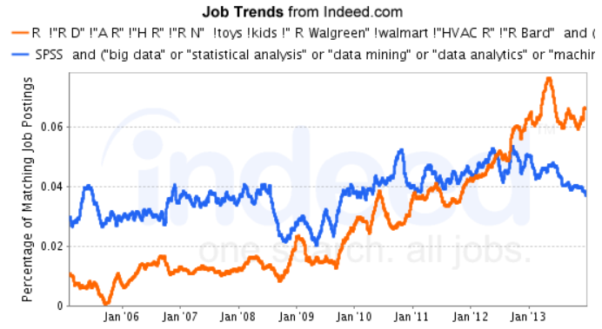
Number of analytics jobs available for R

Slide 42
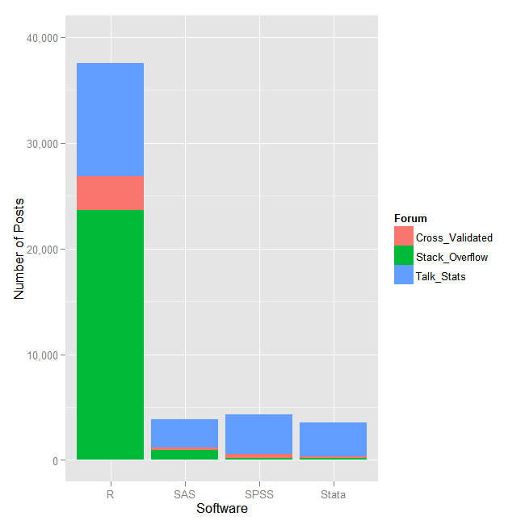
Number of posts (discussions) per software on each forum on 2/10/2013
A recent survey by Rexer Analytics found that R, the open source statistical programming language, is used by 70 percent of data miners. (data-informed.com, Nov 2013)

Slide 43
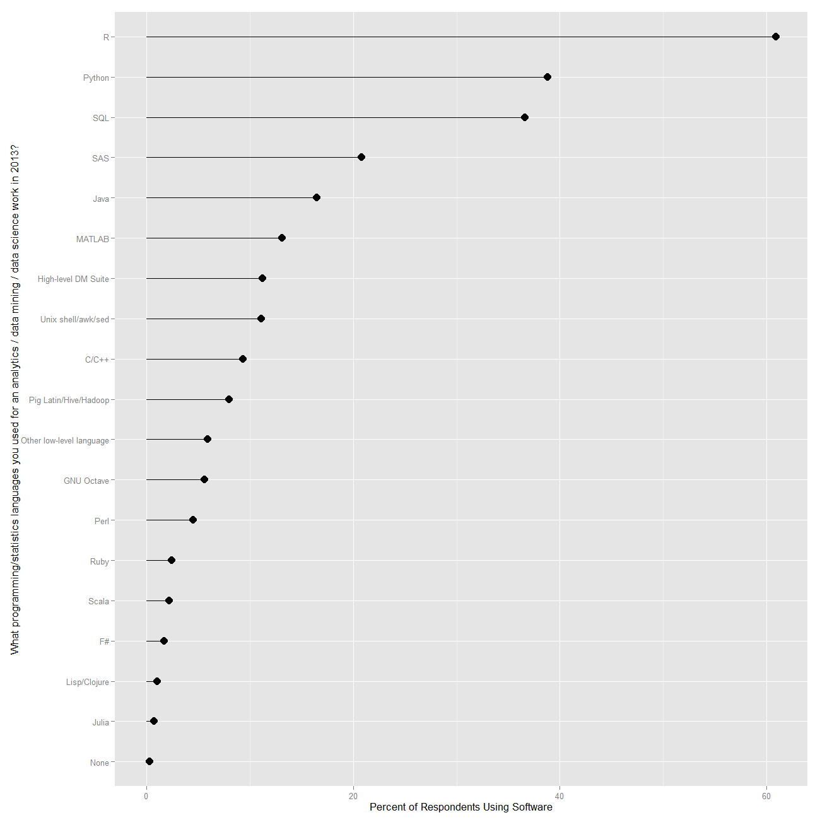
What programming languages you used for data mining /data analysis in the past 12 months? (by KDnuggets)

Slide 44
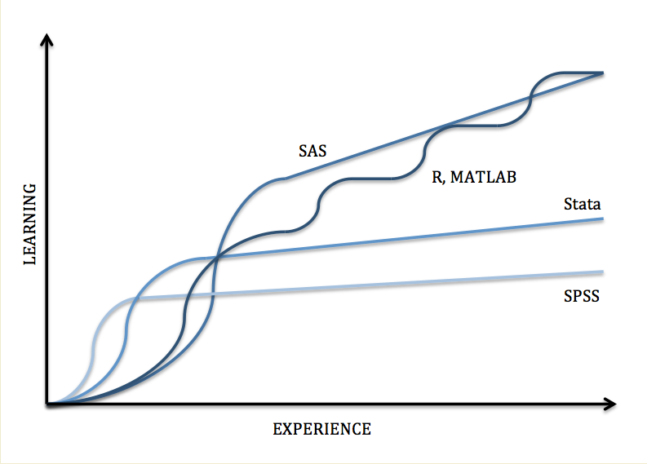
Learning Curve Comparison
We need some patience and efforts at the beginning…

Slide 45
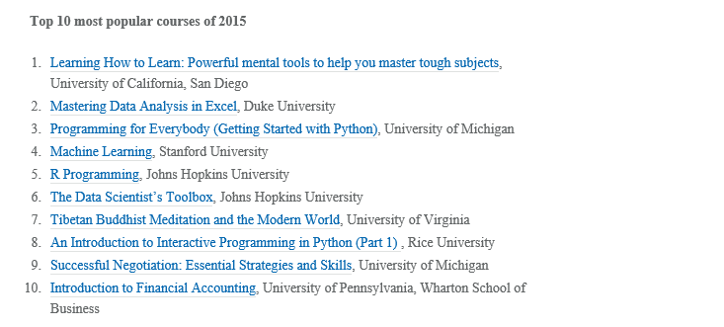
Top 10 most popular courses in Coursera (2015)

Slide 46
Now, let’s install R
If you are familiar with one Software, it is relatively easy to learn the other software!
Download from the CRAN website

Slide 47
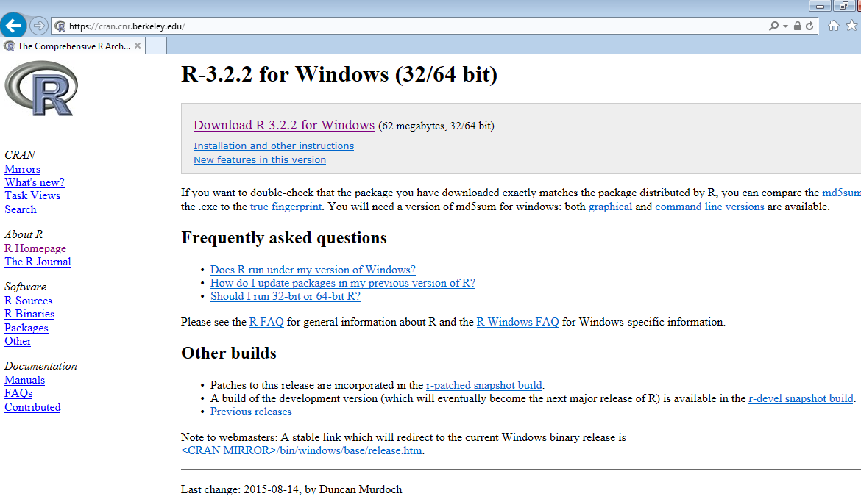
R instillation
www.r-project.org → click “download R” → choose any link (e.g., https://cran.cnr.Berkeley.edu/ here) → we will move to https://cran.cnr.berkeley.edu/ → click “Download R for Windows” here (you may choose other OS such as Linux or Mac). → click “install R for the first time” → click “Download R 3.2.2 for Windows” (see the screen shot below)
Rstudio is also available for Windows, Mac OS X and Linux at http://www.rstudio.com.

Slide 48
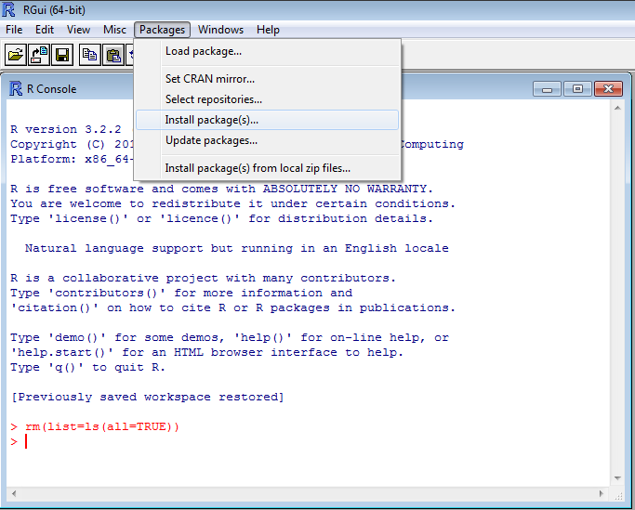
Install add-on Packages
Search any analytics methods in Internet (e.g., Google): for example, Probit Regression in R package → find the package name of the method.
Go to “Packages” → “Install Package(s)” → Choose any link (e.g., USA (CA1)) → Select any package you want to install → call the installed package using command “library (MASS)”.
As alternative: install.packages(c("MASS","tm"))

Slide 49

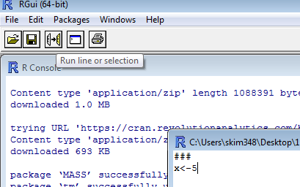
Let’s start R
You can directly work in console window but I prefer to work in script window, because we can save the script history for future R programming:
go to save (or save as) → select directory → write file name and click save.
As an alternative, you can “copy and paste” all commands in a text file.
The selected R commands can be executed by using
or “ + R”

Slide 50
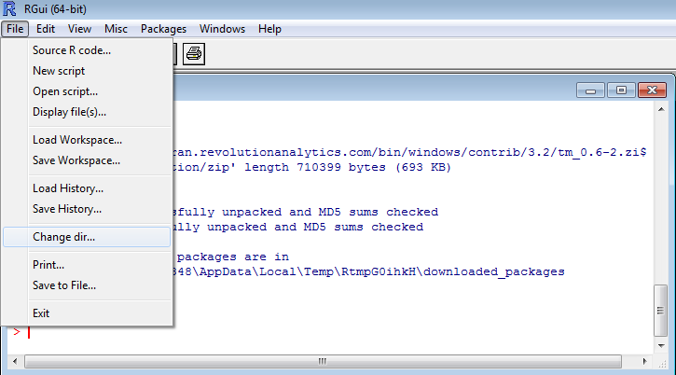
Change working directory
Or, use R command: setwd, E.g., setwd("D:/ASU_Marketing/");

Slide 51
Suggested Steps for using
Identify problem (i.e., managerial problem & technical problem).
Decide analytics model (e.g., CrossTab or Regression?) you need.
If you don’t remember, please searching references (e.g., Internet, textbook) and find relevant commands in R.
Usually, example is very helpful!
Running and interpreting the results by R.
Apply the results to solve the problem.
Save any R codes you’ve used for future (keep adding new useful codes and reuse it for new data).
I will explain details more later, when we use and practice R

Slide 52
Importing and Exporting Data
There are several formats to import data: .csv file, txt file, .dat file, excel file.
Let’s try to import and export csv data file (my preference, but no special reason…).
read.csv(“filename.csv”)
write.csv(object_name, “filename.csv”).
If you want to use the Excel files as it is, you can use R package “xlsx”
Use command read.xlsx or write.xlsx after installing and calling the package “xlsx”.
Assign (simple and recognizable) file names for the imported data:
E.g., Store1<-read.csv(“store-df.csv”)

Slide 53
Checking data once you imported it
Check dimension: dim(Store1)
Inspect of the data with only one or several rows:
Type in Console window: Store1[1,] or Store1[1:4,]
Head(Store1) to see several first rows of the data

Slide 54
More in-class Practice
How to create vector or matrix?
Check basic objects (numeric or logical).
Indexing.
Random value generation.
Looping.
For more example, please see textbook.

Slide 55
Short In-class practice
# draw random 1000 values from standard normal distibution
# draw random 1000 values from normal distibution with mean 0, variance 2
# make histogram plots

Slide 56
Useful Websites for learning R
http://www.ats.ucla.edu/stat/r/

Slide 57
MKT 591: Course Roadmap of Marketing Analytics
For Next Class
Basic Quant Market Research
Prediction / Regression
Forecasting
Features & Dimensions
Market Segmentation
Simple Linear Regression
Demand Forecasting
Classification
Factor Analysis
Segmentation Basic
Measurement Scales
Discriminant Analysis
Categorical Variables
BASS Model
MDS
Advanced Model-based Segmentation
Discrete Analysis (CrossTab)
Bayes Classifier
Extracting Features by Text Mining
Multiple Regression
CART, Random Forest
Geographical Segmentation
Continuous Analysis (Correlation)
Logistic Regression

